Slide 1
Unit 9: For Live Session Assignment
Simple Linear Regression!

Slide 2
Part 1

Slide 3
Quick Quiz Questions

Slide 4
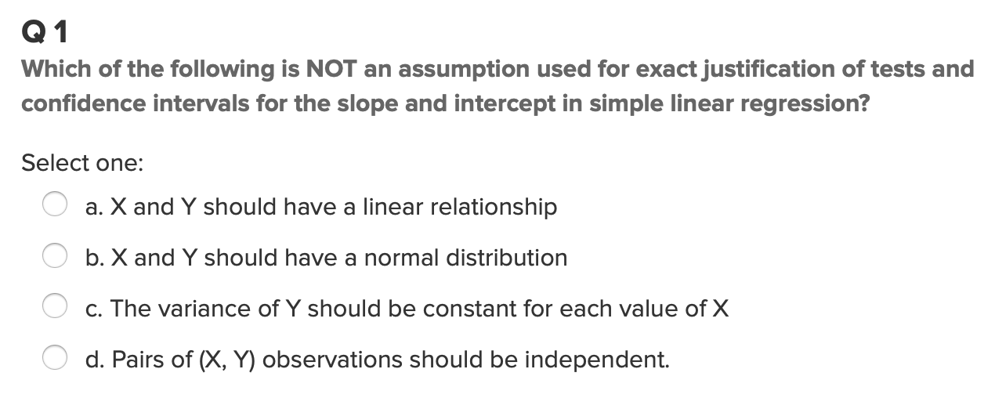
Question 1 (<15 min)

Slide 5
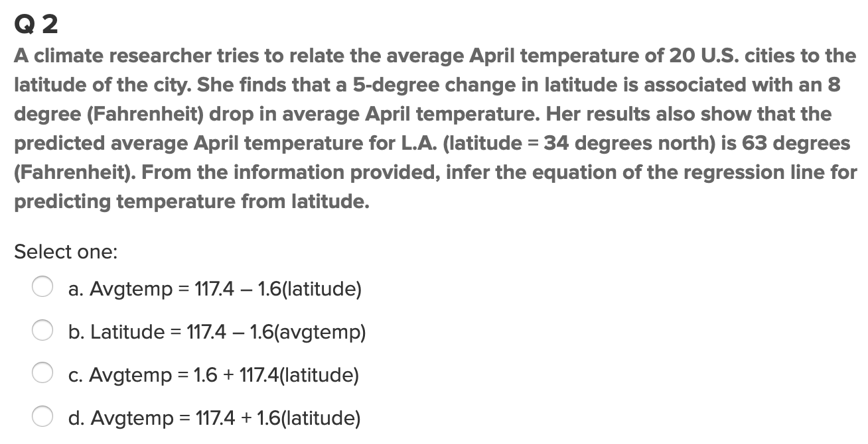
Question 2 (< 15 min)

Slide 6
End Part 1

Slide 7
Part 2

Slide 8
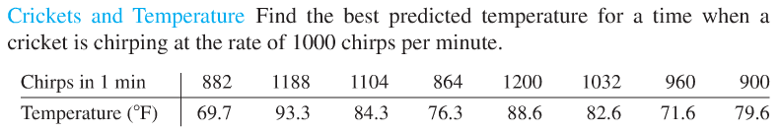
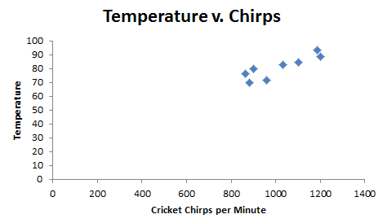
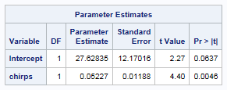
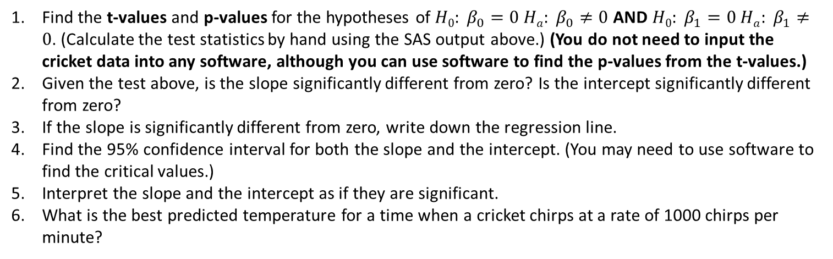
Crickets!!!
Find the t-values and p-values for the hypotheses of $H0: β_{0}=0{ Ha: β}_{0}≠0$ AND $H0: β_{1}=0{ Ha: β}_{1}≠0$. (Calculate the test statistics by hand using the SAS output above.) (You do not need to input the cricket data into any software, although you can use software to find the p-values from the t-values.)
Given the test above, is the slope significantly different from zero? Is the intercept significantly different from zero?
If the slope is significantly different from zero, write down the regression line.
Find the 95% confidence interval for both the slope and the intercept. (You may need to use software to find the critical values.)
Interpret the slope and the intercept as if they are significant.
What is the best predicted temperature for a time when a cricket chirps at a rate of 1000 chirps per minute?

Slide 9
End Part 2

Slide 10
Part 3

Slide 11
Takeaways and Questions (1 hour)
Please remember to record you takeways and any questions you may have!

Slide 12
End Part 3

Slide 13
End Unit 9 For Live Session Assignment

